Slide 1
Project 2 – Part 3
Adam Kolodny

Slide 2
Project 2 – Part 3
The dataframe consists of information on people who have downloaded our fitness app.
The data contains user information, some pertinent to the analysis and some not.
In addition, the dataframe indicates whether a someone has done a workout with the app.
The goal of the ultimate project is to:
Create a model to predict whether or not a user actually does a workout
Create a model to find the clusters of those who:
Download
Do a workout

Slide 3
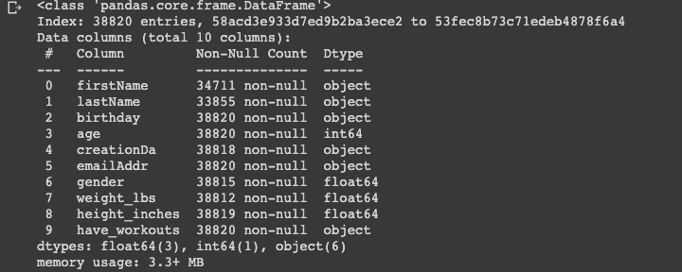
This is the outline of my dataframe before any clean up is done.
There are a number of features not needed and missing data.

Slide 4
The first step I took was to eliminate the features that were not needed for my analysis:
First name
Last Name
Creation Date
Email Address
Birthday
df.drop(columns= 'firstName',inplace =True)
df.drop(columns= 'lastName',inplace=True)
df.drop(columns='creationDa',inplace=True)
df.drop(columns='emailAddr', inplace =True)
df.drop(columns= 'birthday',inplace = True)
df.info()

Slide 5
df['have_workouts'] = df['have_workouts'].replace({'yes': "Yes"})
Next, I cleaned up my target group to make the entries uniform. All Yes or No.

Slide 6
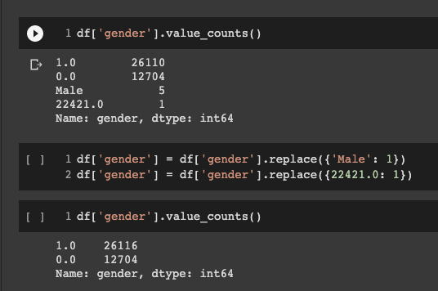
Next step was to clean up the gender field so that all of the data was numeric.

Slide 7
df['weight_lbs'].fillna(value= 0, inplace=True)
df['height_inches'].fillna(value= 0, inplace=True)
Since the values missing for these categories was minimal I choose to fill them with a value of zero

Slide 8
mean_value = df['age'].mean()
df['age'].fillna(value=mean_value,inplace=True)
df.head()
Since this feature was not missing a lot of entries I choose to fill in the missing values with the mean age of the rest of the data set.

